Slide 1
IOT BASED ACCURATE THERMAL SCREENING AND ALERT FOR COVID SITUATION USING BEAGLEBONE
Submitted By:
Rasandeep Singh
C0727753

Slide 2

Amazon Web Services
Amazon Web Services (AWS) is a secure cloud services platform, offering compute power, database storage, content delivery and other functionality to help businesses scale and grow.
It provides services such as S3, lambda, RDS, DynamoDB, Elastic beanstalk etc.
Img src: https://fintech-alliance.com/news-insights/article/3292/klarna-signs-deal-with-aws/cloud

Slide 3

Amazon Simple Storage Service (S3)
Amazon S3 has a simple web services interface that you can use to store and retrieve any amount of data, at any time, from anywhere on the web.
https://medium.com/@dolicag/a-story-of-simple-storage-service-aws-s3-3f4f8cbc2dd7

Slide 4
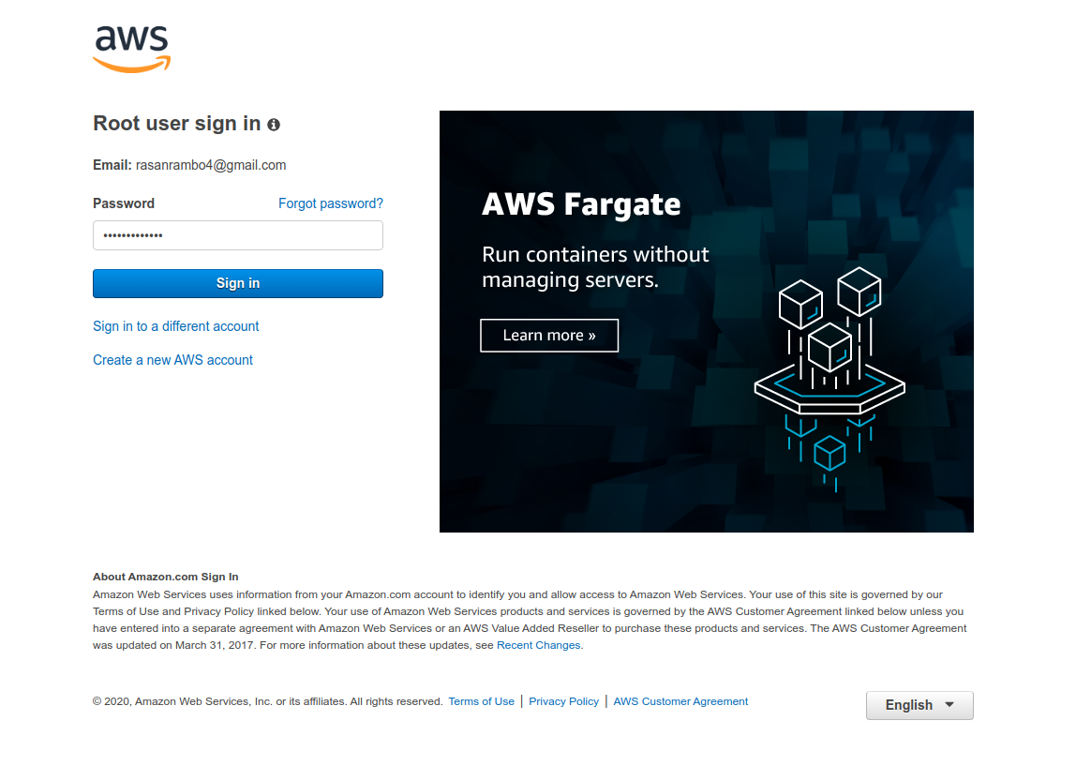
Login into the AWS account

Slide 5
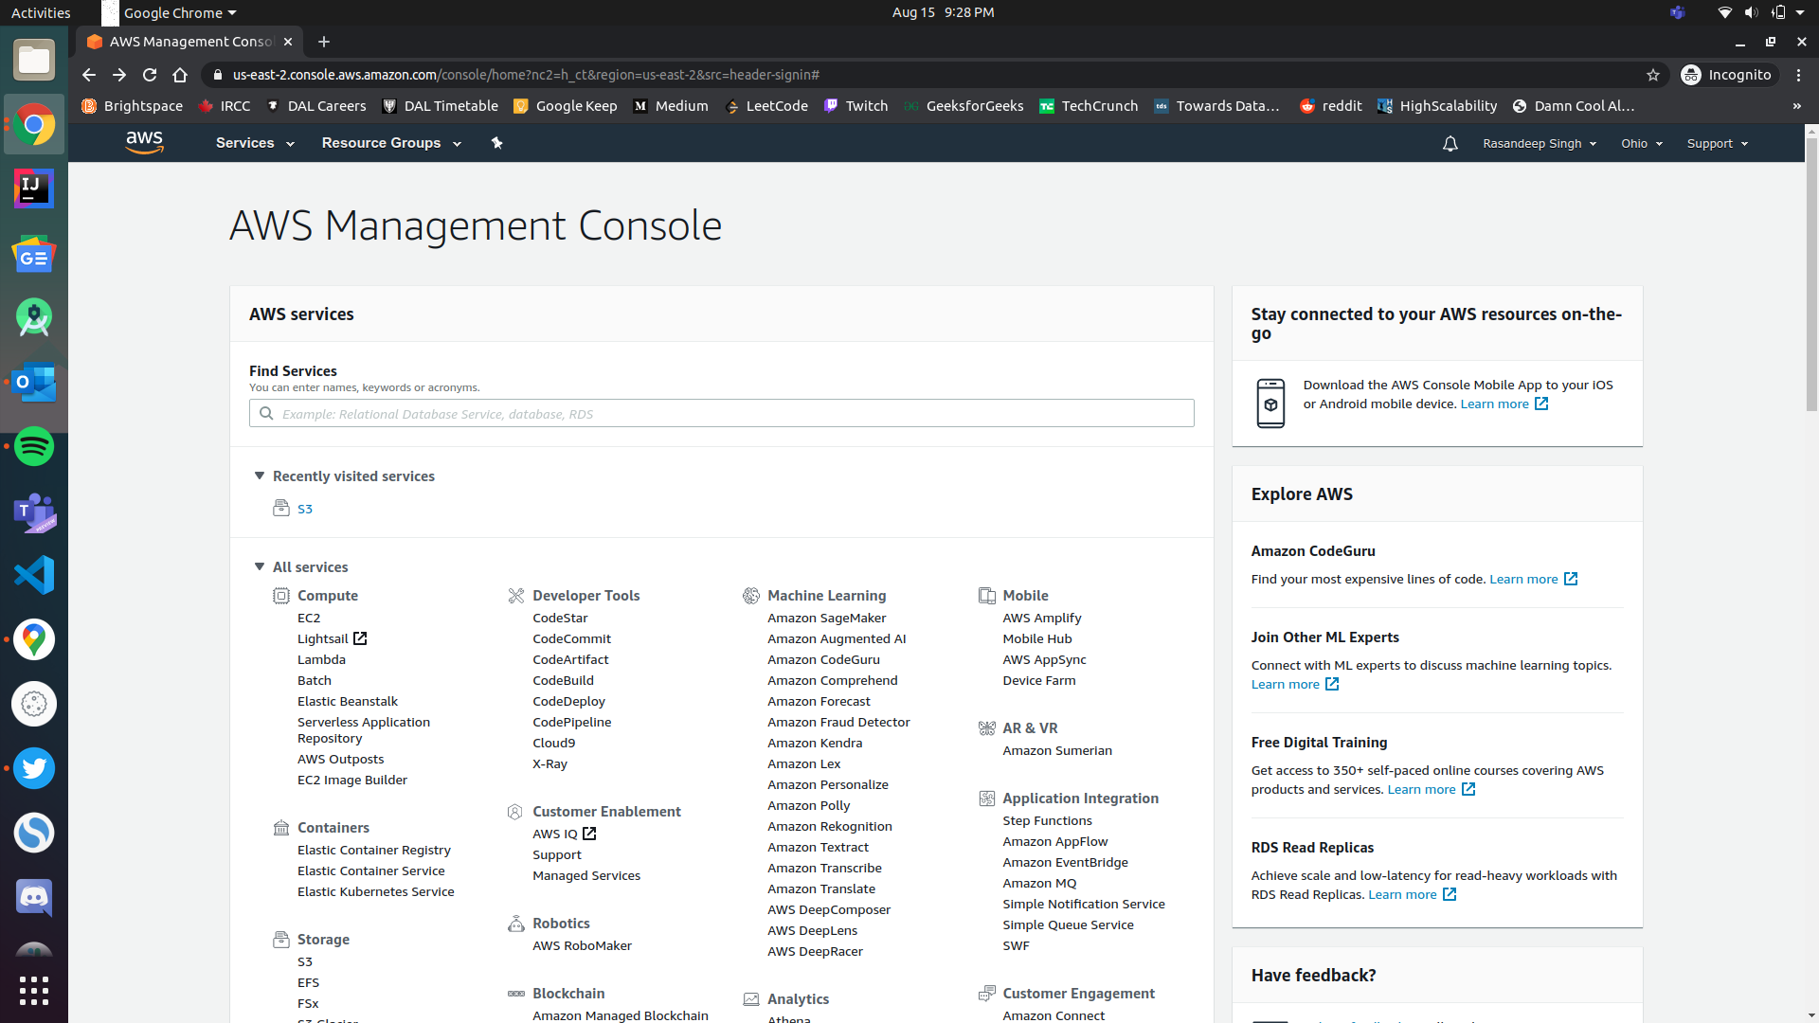
AWS Management Console

Slide 6
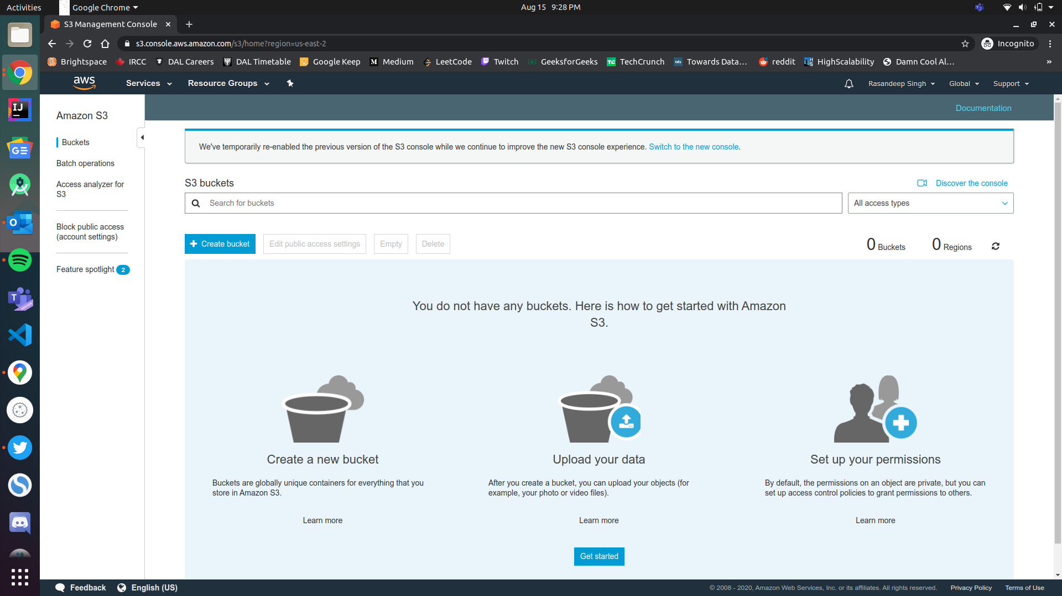
AWS Console for S3

Slide 7
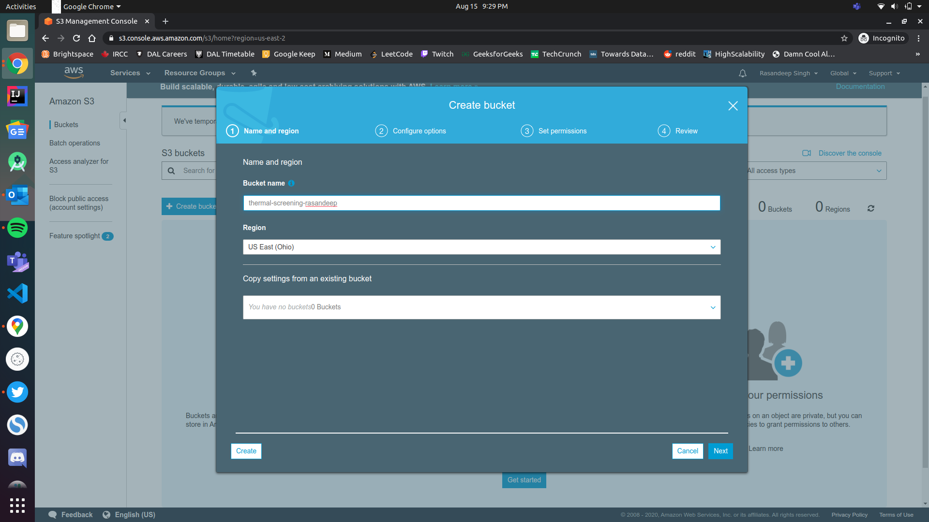
Creating a new bucket for the project

Slide 8
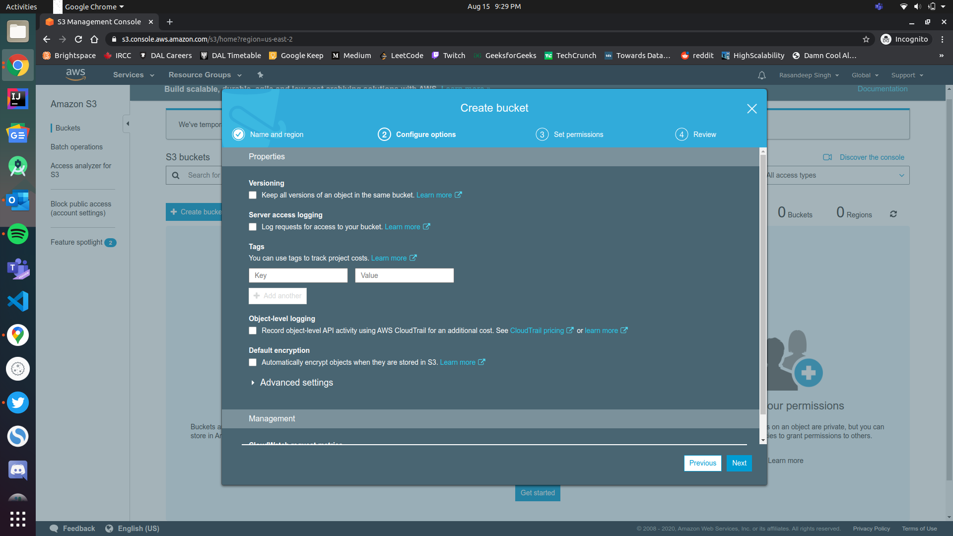
Configuration options for the bucket

Slide 9
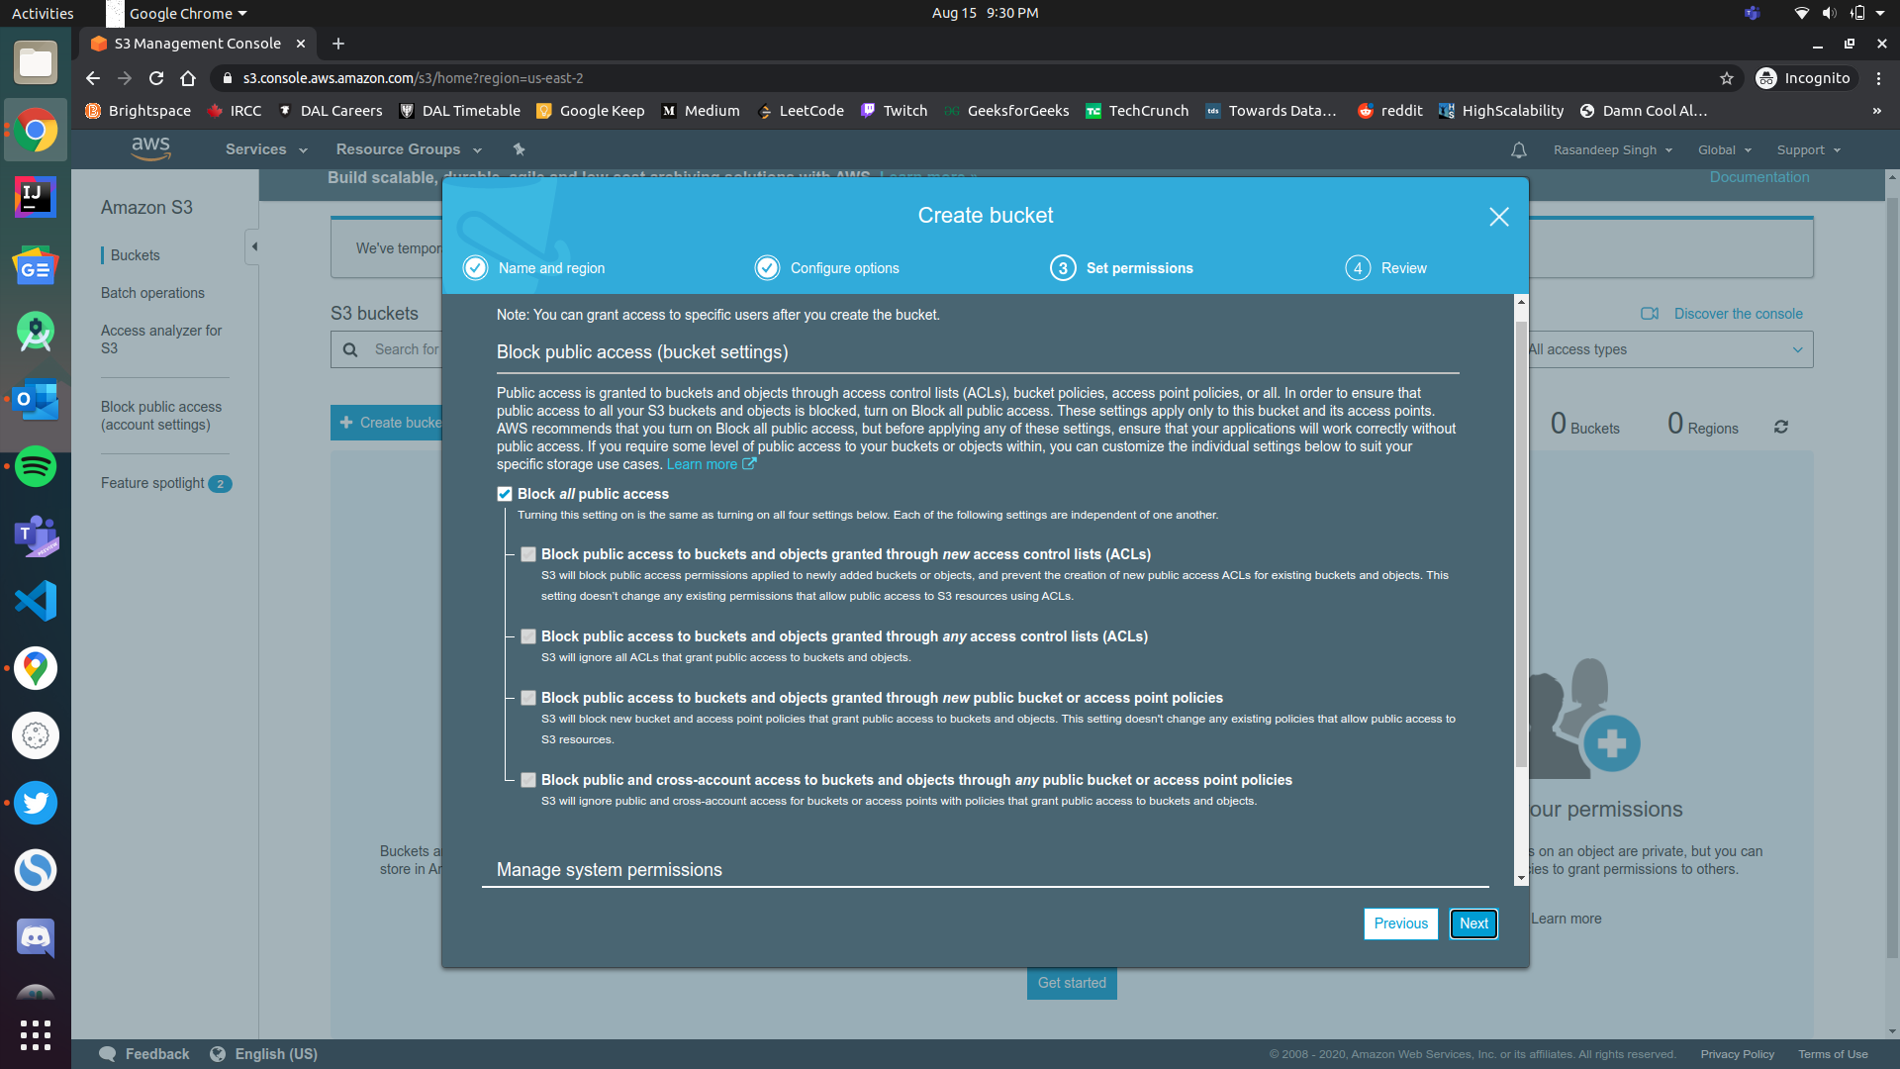
Access control settings for the bucket

Slide 10
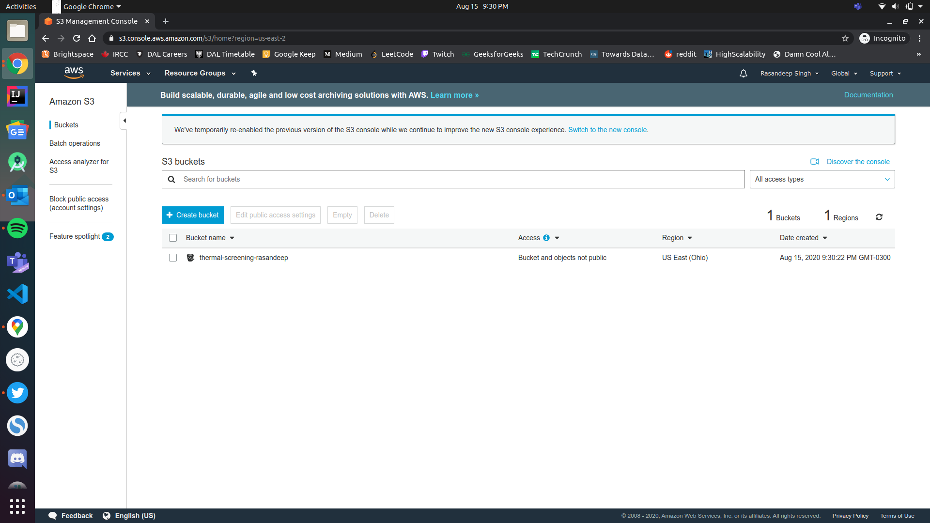
Bucket (thermal-screening-rasan) created

Slide 11
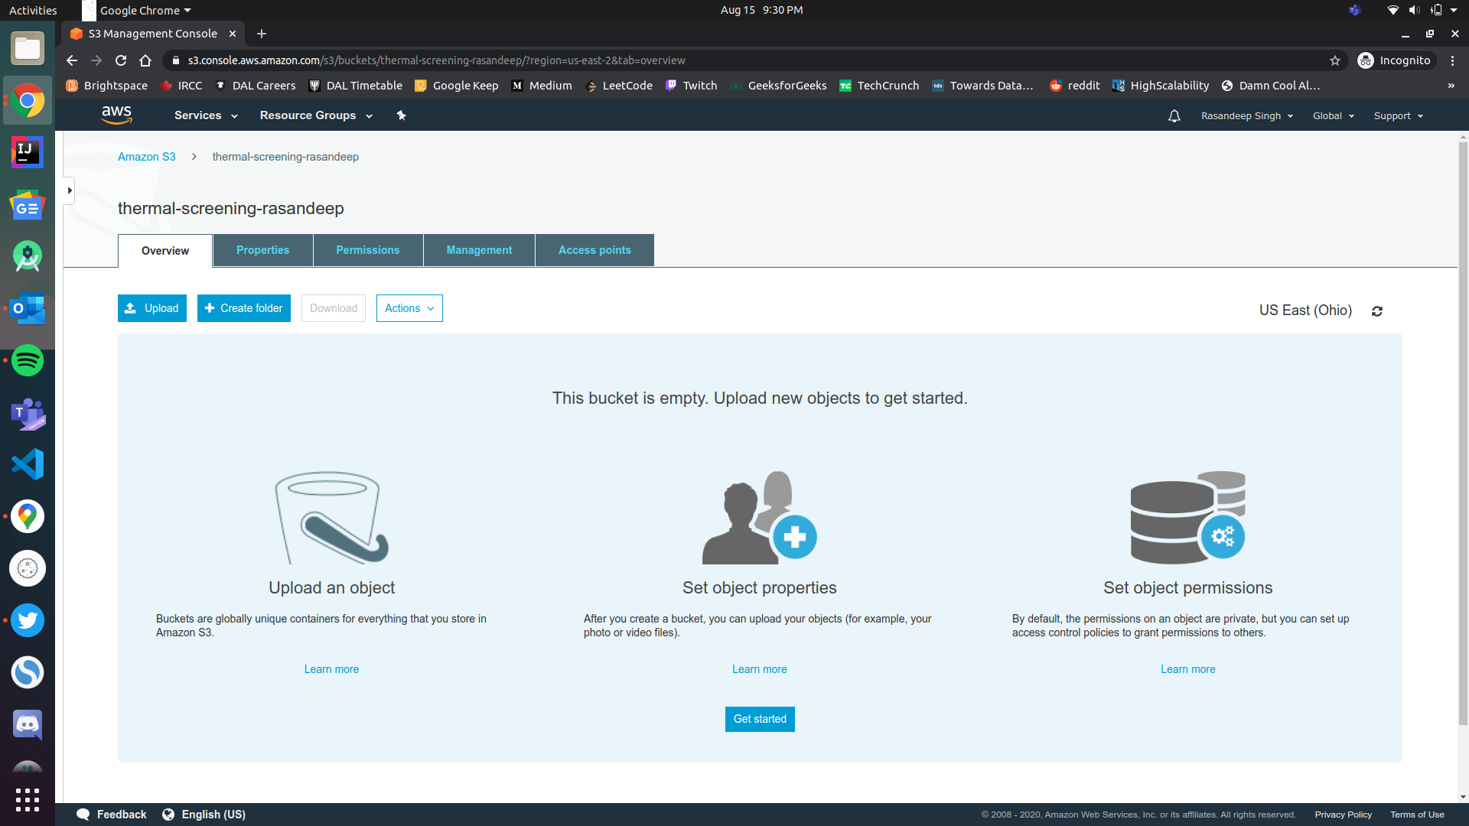
Console for the bucket

Slide 12
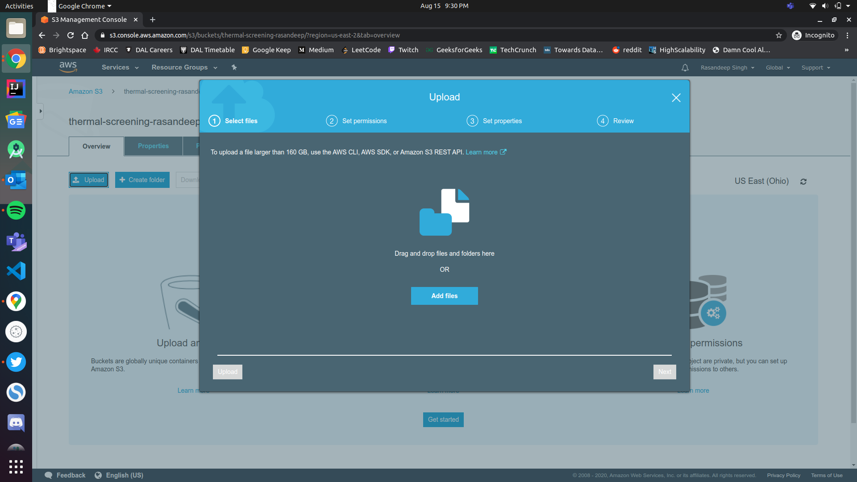
Adding new files to the bucket

Slide 13
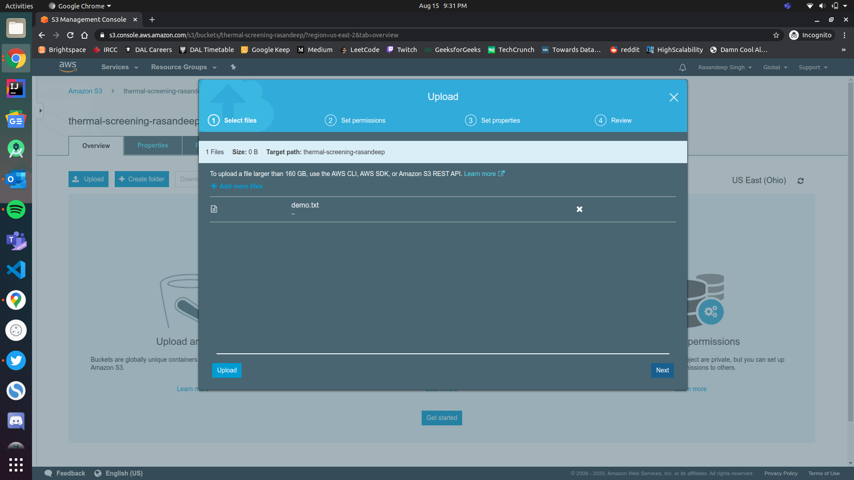
Added a demo.txt file to the bucket

Slide 14
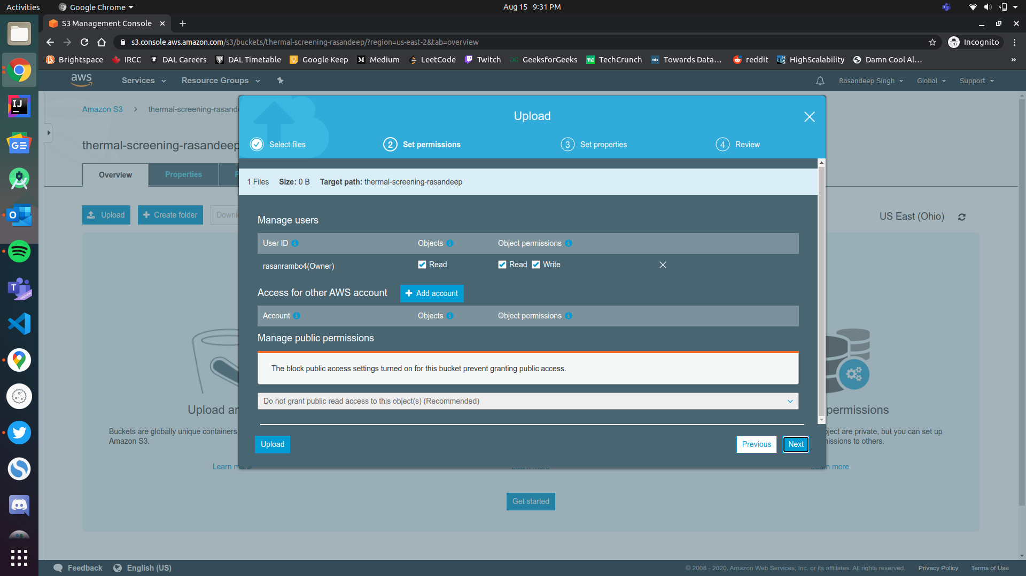
Access control options for the new object

Slide 15
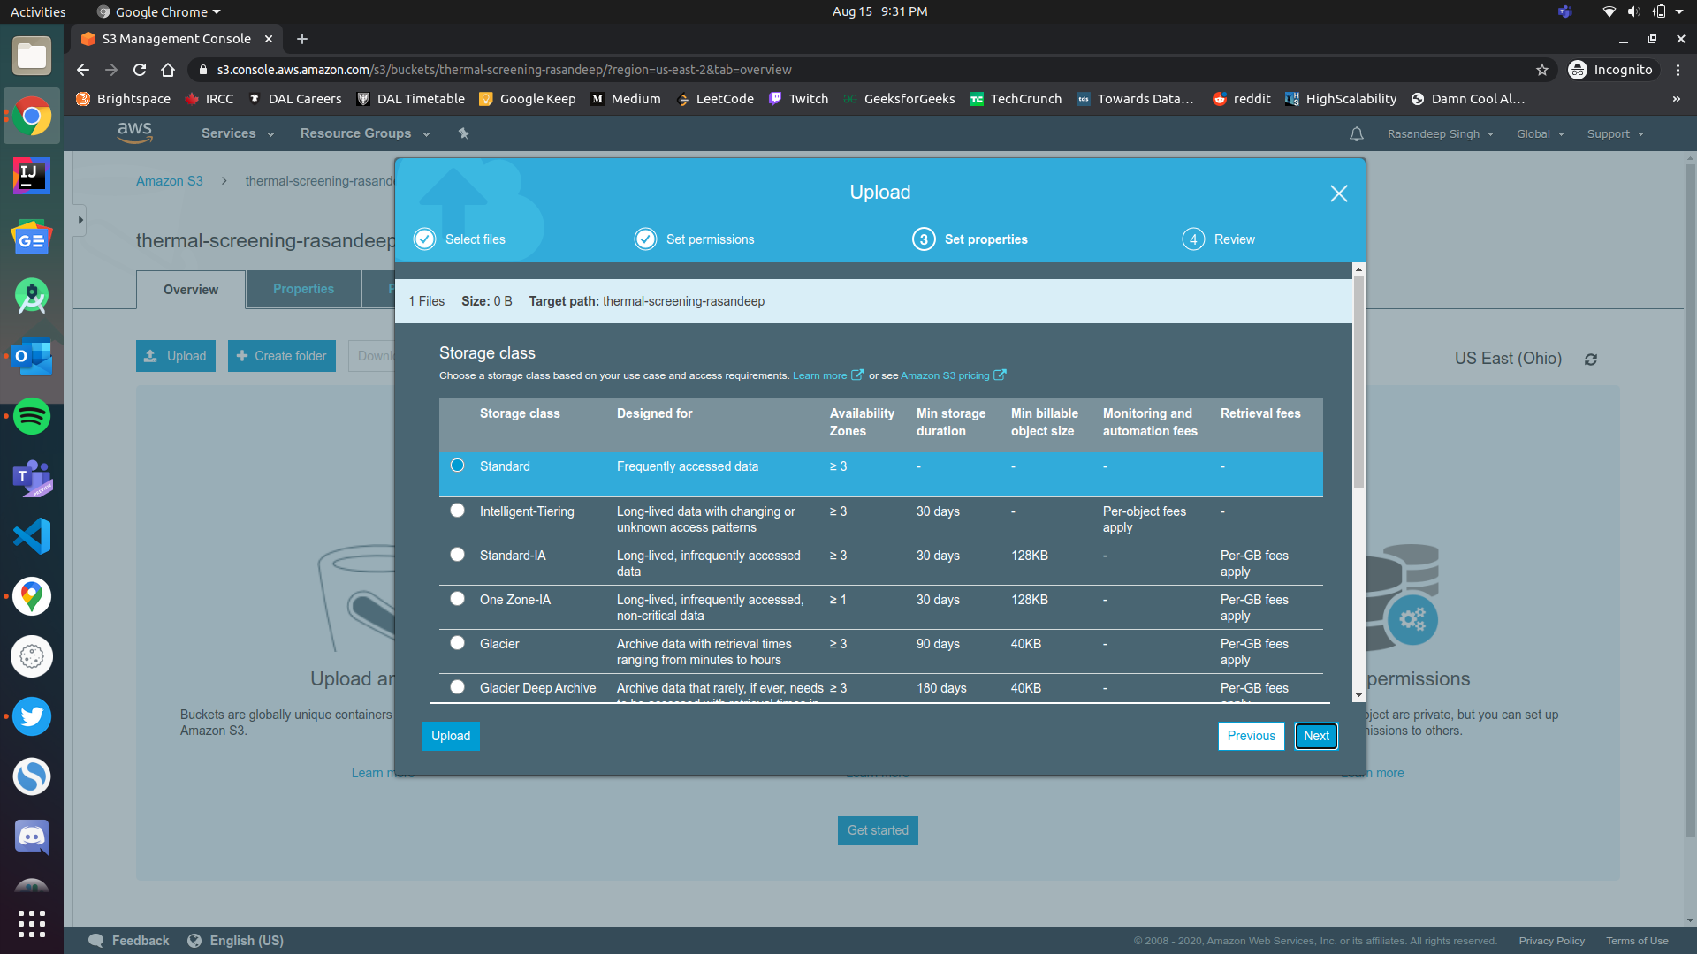
Storage class option for the new object

Slide 16
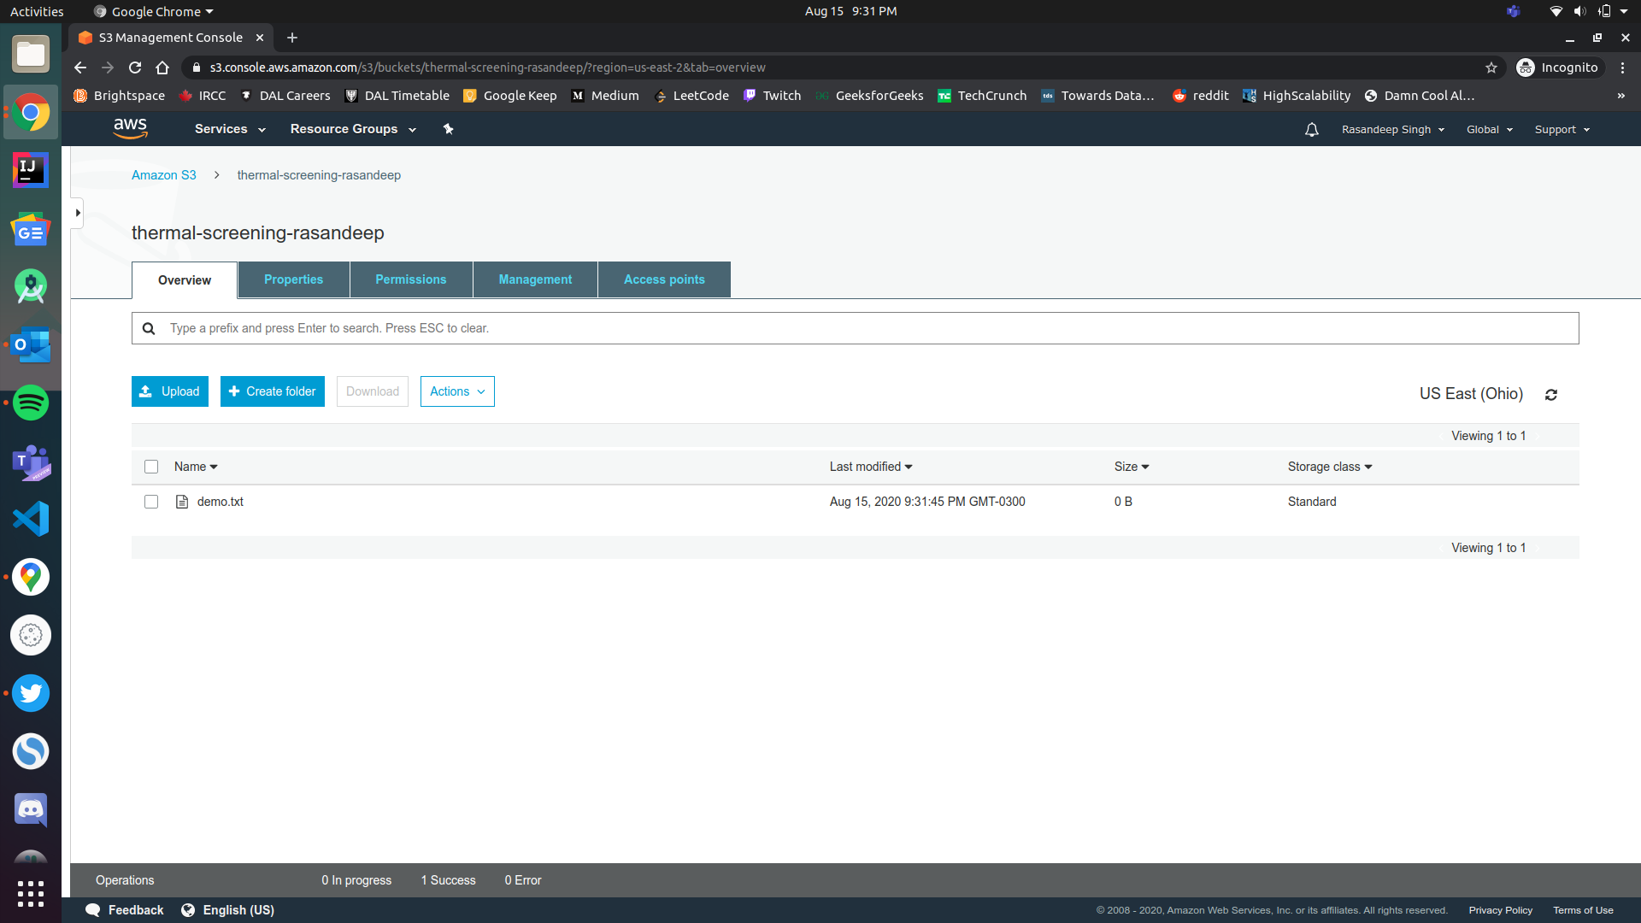
File added to the bucket

Slide 17
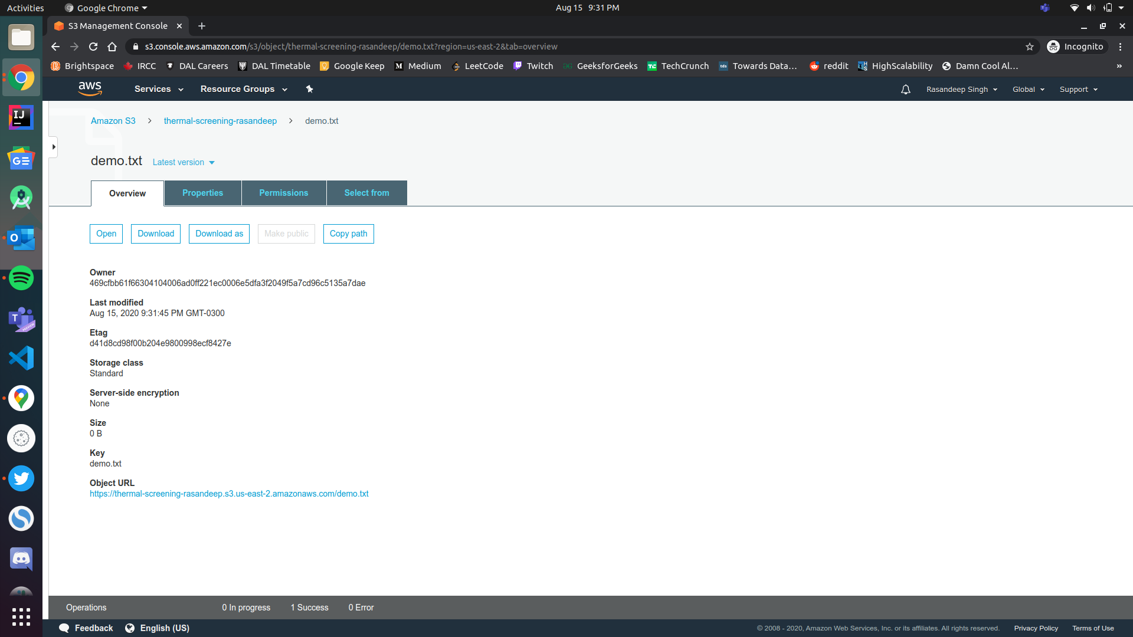
URL for the newly added file.

Slide 18
References
Introduction to Amazon S3 - Amazon Simple Storage Service. (2020). amazon.com. https://docs.aws.amazon.com/AmazonS3/latest/dev/Introduction.html
‌Sanjeev Gautam. (2019). Amazon S3 - Sanjeev Gautam - Medium. Medium; Medium. https://medium.com/@me.sanjeev3d/amazon-s3-4b2ae15f6c4d
(2020). amazon.com. https://docs.aws.amazon.com/

